Slide 1
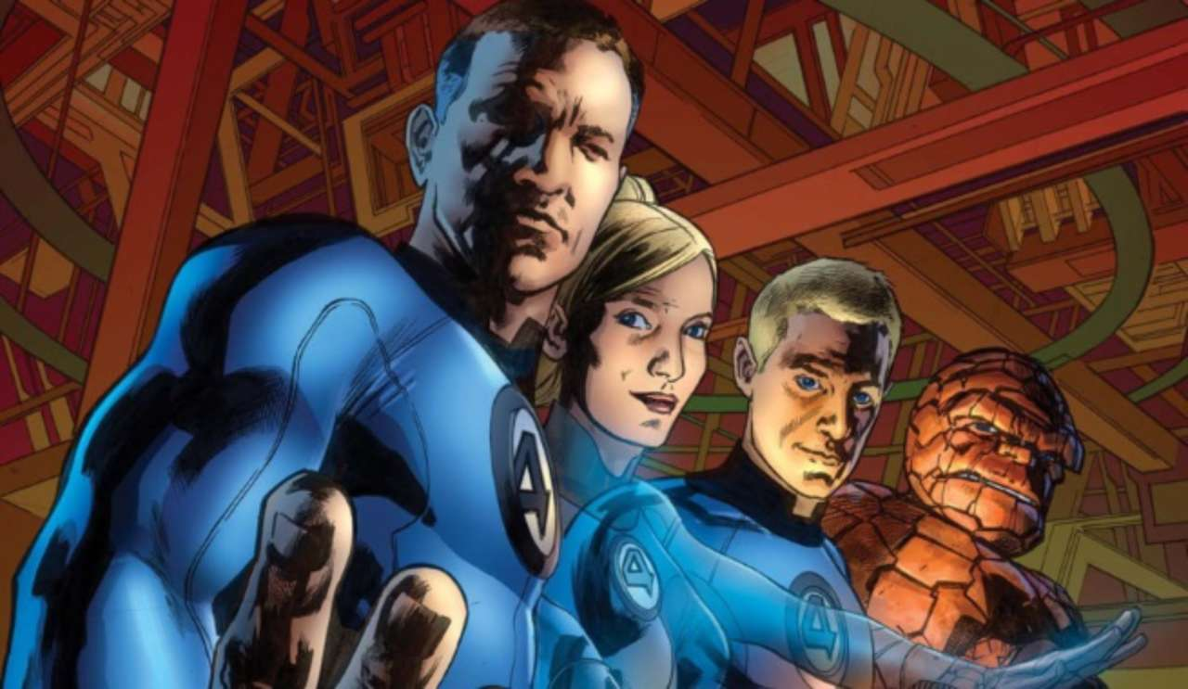
Fantastic Four
Fantastic Four

Slide 2
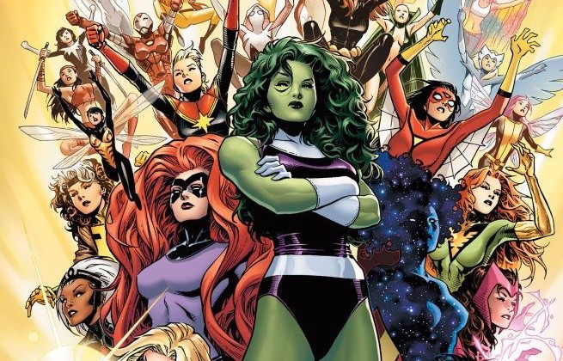
A-Force
A-Force

Slide 3
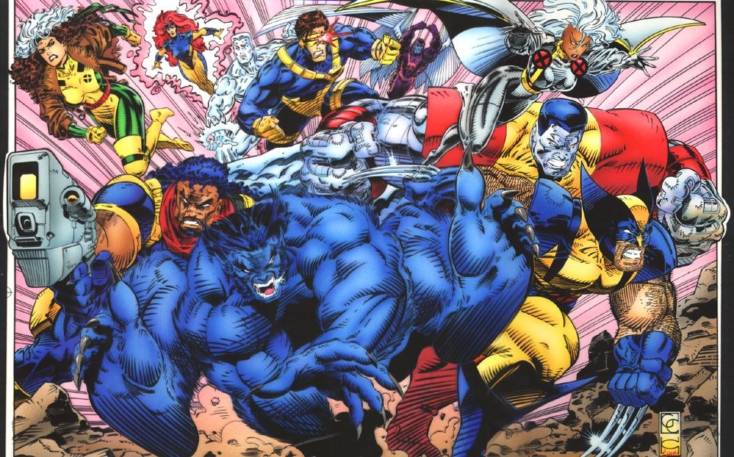
X-Men
X-Men

Slide 4
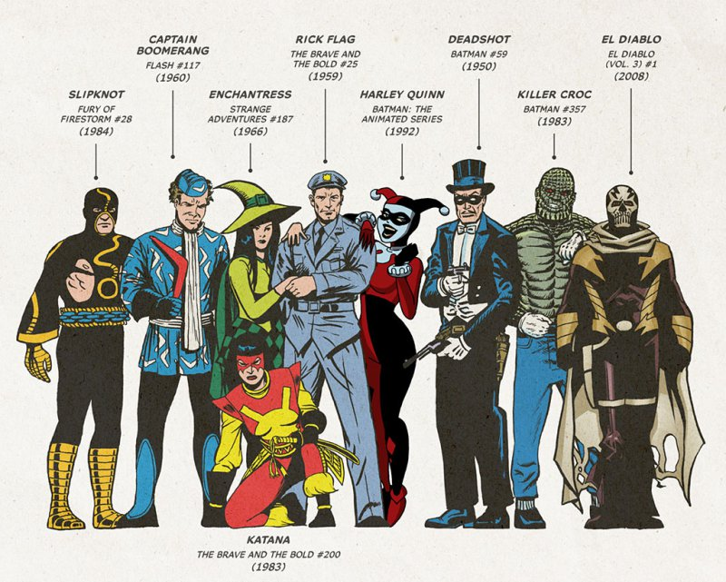
Suicide Squad
Suicide Squad

Slide 5
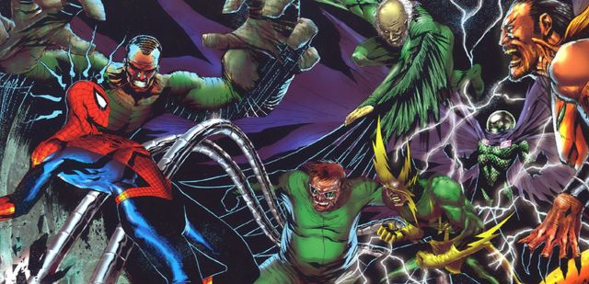
Sinister Six
Sinister Six

Slide 6
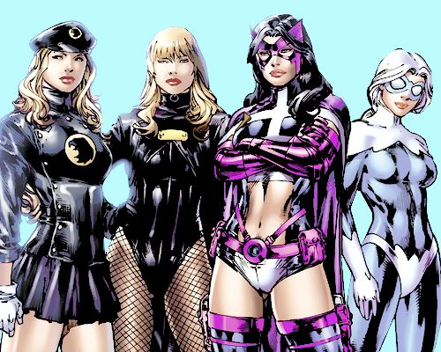
Birds of Prey
Birds of Prey

Slide 7
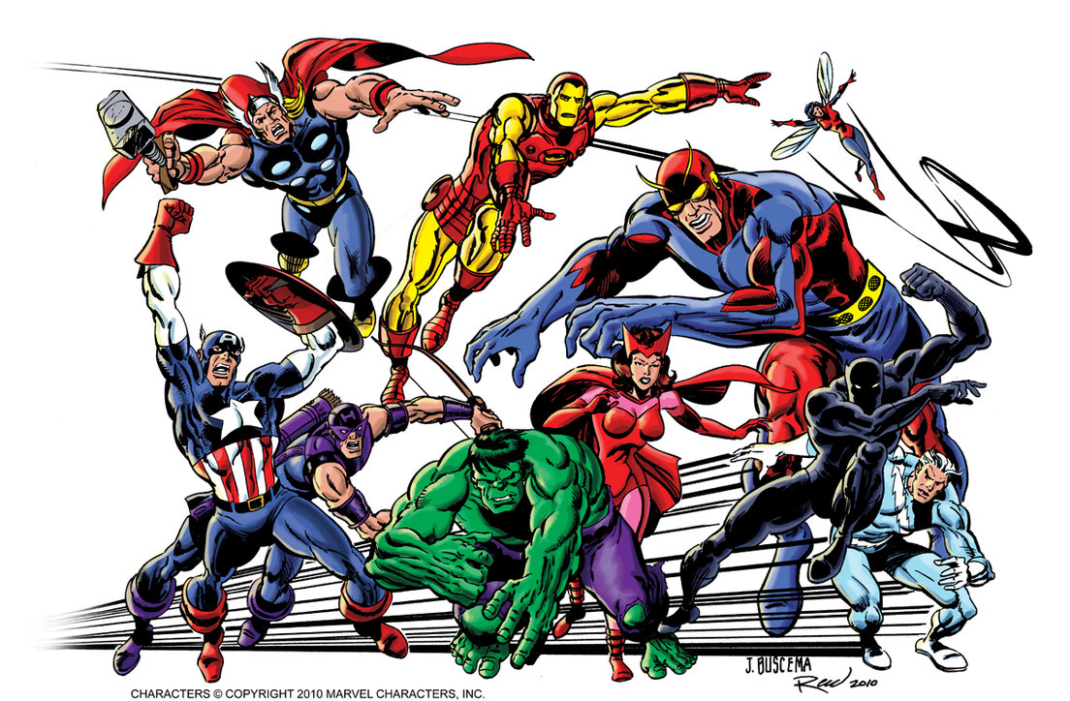
Avengers
Avengers

Slide 8
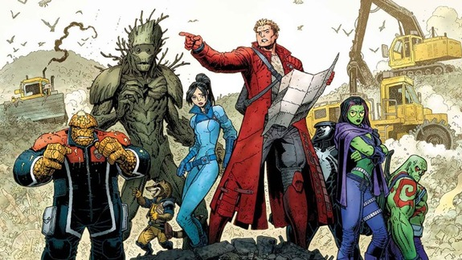
Guardians of the Galaxy
Guardians of the Galaxy

Slide 9
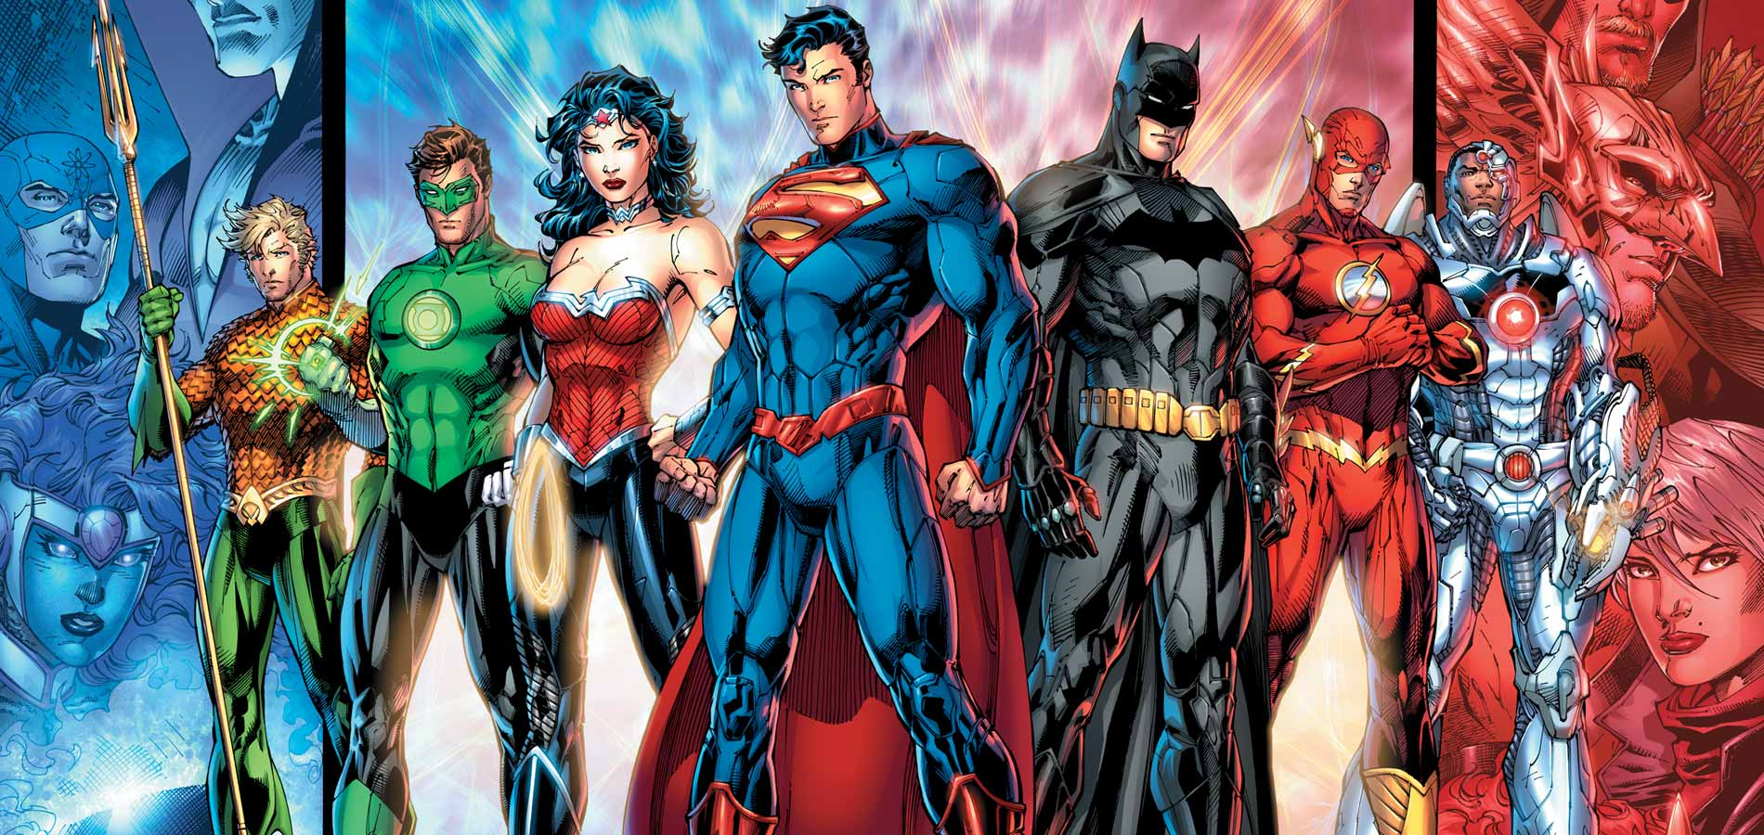
Justice League
Justice League

Slide 10
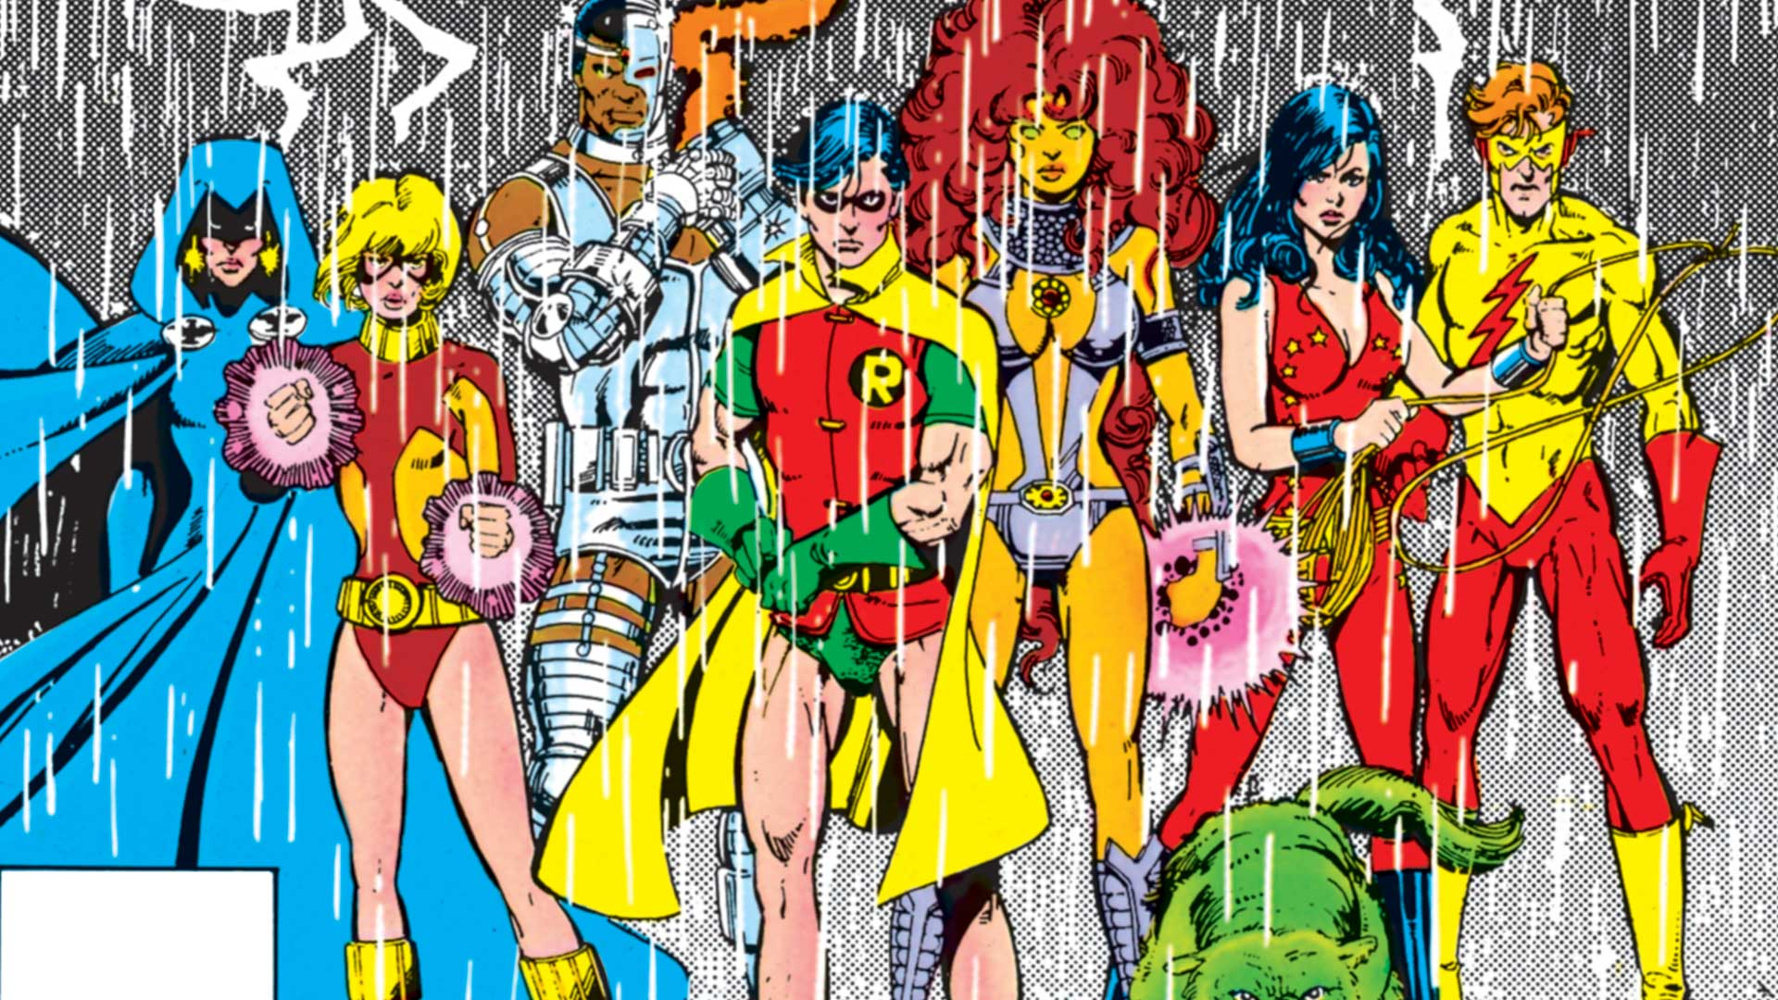
New Teen Titans
New Teen Titans

Slide 11
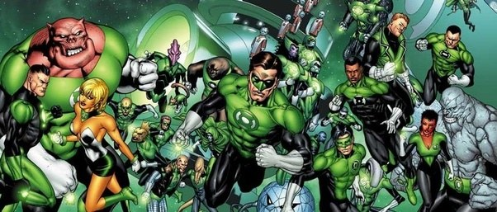
Green Lantern Corps

